Slide 1

ELL Leadership Academy
Karina E. Chapa, M.Ed.
Language Proficiency, Biliteracy
and Cultural Diversity Director
kchapa@esc1.net

Slide 2
Professional Learning Essential Agreements
Be respectful of others
Be an active participant
Take care of your needs
Use electronic devices as learning tools

Slide 3
AGENDA
ELL Video Mingle
Sheltered Instruction Strategies
Planning for Success

Slide 4
Edmodo assignment
ELL Video

Slide 5

Edmodo Code: bmnrkb
Edmodo Assignment
If you brought a video of you presenting ELL info to your staff/peers, get a colored index card.
Let’s mingle!
www.edmodo.com

Slide 6
Sheltered instruction
Strategies

Slide 7

Make an Appointment

Slide 8
Session Objectives
Content Objective
Language Objective
Today I will explore sheltered instruction techniques and strategies to make content comprehensible for my ELLs.
Today I will share different ideas on how to implement sheltered instruction strategies in my classroom.

Slide 9
Three-Step Interview
Stand up when you can complete one of these sentences:
  Teaching ELLs is so difficult because…
  One challenge I face when teaching ELLs is…
  One challenge I face when instructing ELLs is… What I have done to overcome this challenge is…
Beginner
Intermediate
Advanced

Slide 10
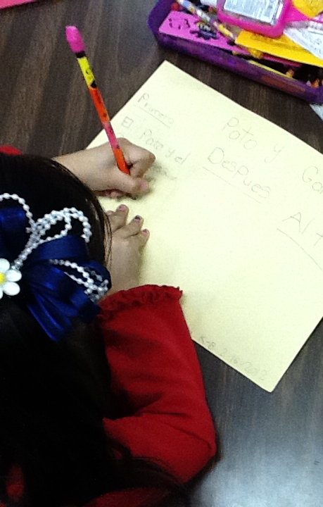
What are the two goals of Sheltered Instruction?
Make Content Comprehensible
Develop Academic Language

Slide 11
Content and language objectives

Slide 12

Anticipation Guide
kahoot.it
create.kahoot.it
Let’s Kahoot!

Slide 13
Round Table
Divide a piece of paper in two sections
Create a T chart
Write everything you know about content and language objectives
15 seconds!
Pass your paper to your right!
Repeat!
Content Objectives
Language Objectives
Let’s Write!

Slide 14
The What and the How
Content Objectives come from the TEKS
What am I going to learn?
Language Objectives come from the ELPS
How will I demonstrate my learning through listening, speaking, reading and/or writing?
Content and Language Objectives

Slide 15
Content Objective - Sample
Science TEKS: Differentiate between structure and function in plant and animal cell organelles including cell membrane, cell wall, nucleus, cytoplasm, mitochondria, chloroplast and vacuole.
Student Friendly format: Today I will compare and contrast the cell structures and functions of plants and animals.

Slide 16
Writing Content Objectives
Pair-up
Analyze a Student Expectation (TEKS) from any content area
Write it in a student-friendly format
You have 2 minutes
Write it on the top of a chart paper

Slide 17
Language Objective - Sample
Content Objective:
Today I will compare and contrast the cell structures and functions of plants and animals.
Language Objective:
Today I will write an essay comparing and contrasting plant and animal cells utilizing transitional phrases.

Slide 18
Writing Language Objectives
Pair-up
Look back at the content objective you wrote
Write a language objective in a student-friendly format
You have 2 minutes
Write it on the chart paper below the content objective

Slide 19
Key Points to Remember
Make objectives student friendly and appropriate for grade level
Objectives are for students, not for the adults in the classroom
Post eye level
Review with students before, during and after each lesson

Slide 20
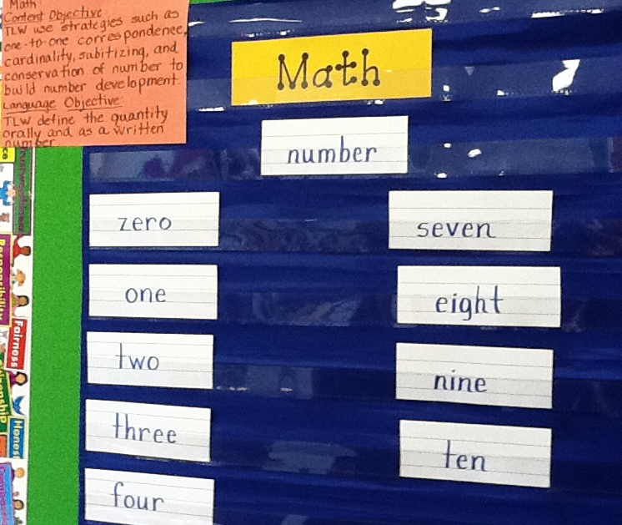
Provide Feedback
Content and Language Objectives

Slide 21
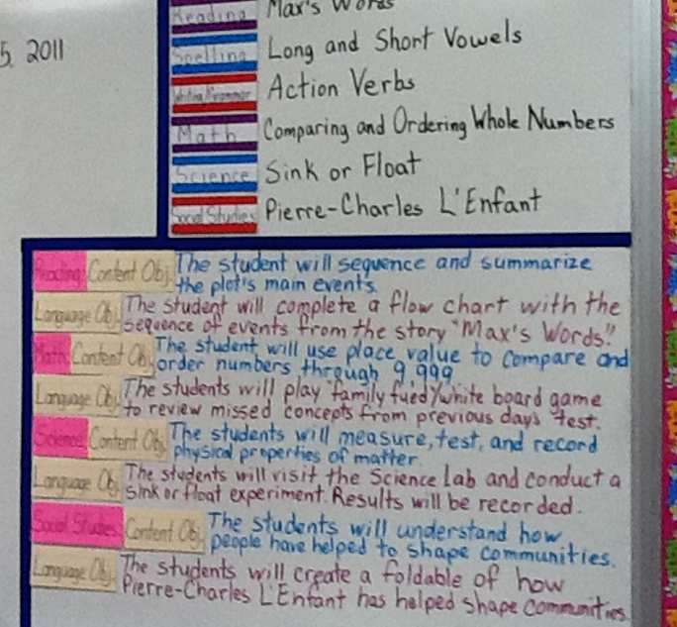
Provide Feedback
Content and Language Objectives

Slide 22
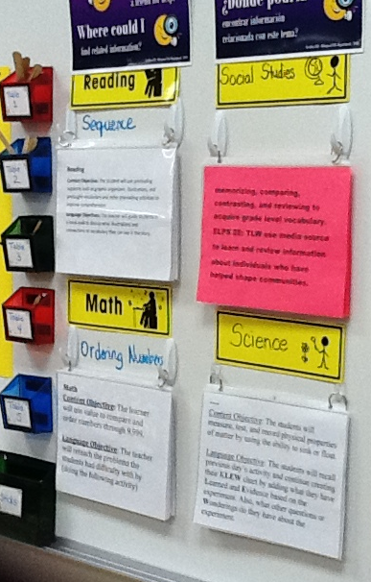
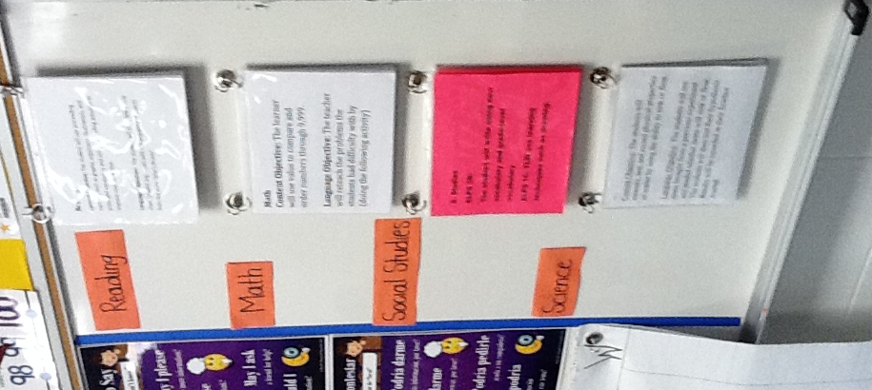
Provide Feedback

Slide 23
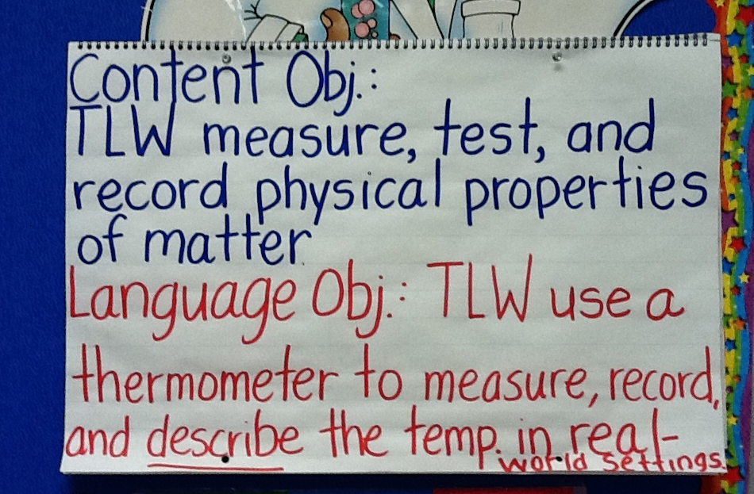
Provide Feedback

Slide 24
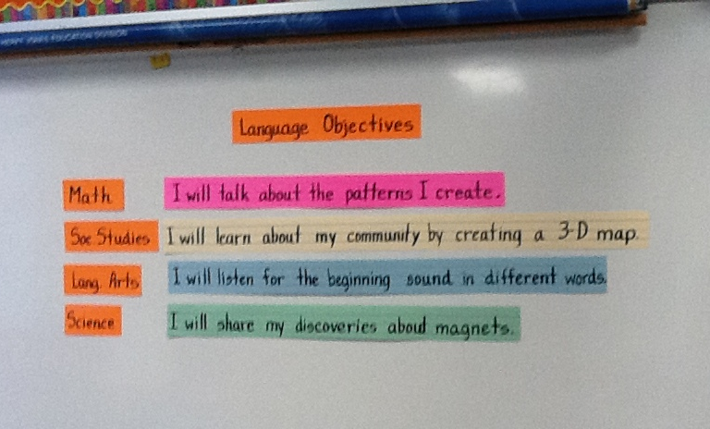
Provide Feedback

Slide 25
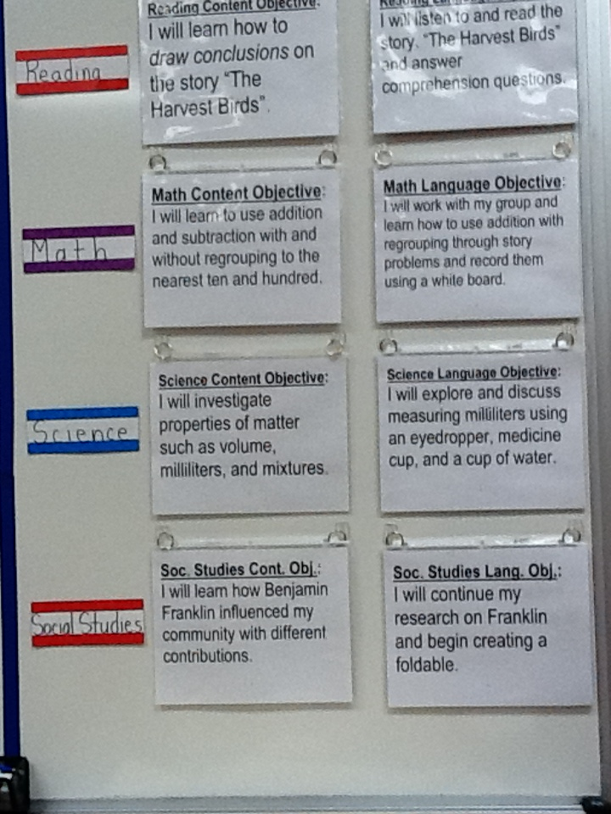
Provide Feedback
Content and Language Objectives

Slide 26
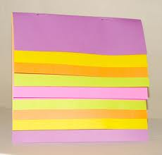
SHELTERED INSTRUCTION
Content and Language Objective

Slide 27
Speaking in complete sentences

Slide 28
1-2-4-ALL
Why is it important to encourage English Learners to speak in complete sentences?
Write your individual answer on a piece of paper.
Share with a partner and add any new ideas to your paper.
Now share with another pair your answers and keep adding new ideas to your own papers.
As a whole table come up with a final complete answer.

Slide 29
Share Your Answers
iRandomizer App

Slide 30
Use of Complete Sentences
Does this mean that students need to answer in complete sentences all the time?
TIP:
Provide students with sentence frames and sentence starters if they are struggling to produce complete thoughts in English.

Slide 31
Use of Complete Sentences
  1. When reviewing a handout or worksheet
    Non-Example
    Teacher: How much is 5 X 4?
    Student: 20!
    Example
    Teacher: What is the product of 5 X 4?
    Student: The product of 5 and 4 is 20

Slide 32
Use of Complete Sentences
  2. When students are given sentence starters
    Non-Example
    Teacher: Who is your favorite character and why?
    Student: Esperanza!
    Example
    Teacher: Who is your favorite character and why? Please complete the following sentence: “My favorite character is… because…”
    Student: My favorite character is Esperanza, because she was very brave.

Slide 33
Your Turn! Gallery Walk!
Using the Content and Language Objectives that you developed, write 3 questions and 3 sentence stems that your students might be able to answer throughout the lesson.
Write them on post-its and place them on your chart paper.

Slide 34
SHELTERED INSTRUCTION
Content and Language Objective
Using Complete Sentences

Slide 35
RANDOMIZATION TECHNIQUES

Slide 36
Randomization Techniques
Write-Read-Read-Trade
Stand up when you complete in writing one of these sentences:
  I select who I call on by…
  In my classroom, I include randomization because…
  The most beneficial randomization technique I have used is… because…
  Find your 12 o’clock, share your answers and trade your papers.

Slide 37
Randomization Techniques
Is it possible to randomize and differentiate instruction at the same time?
Randomize and rotate who is called on,
so students of all language levels can participate!

Slide 38
Randomization Techniques
Lucky sticks
Beach ball
Index cards
with student names
Class list/roster
Color/numbers
Birthdays
Physical characteristics: longest hair, eye color…
Jenga
Pick up sticks
Career cards
Apps
Popcorn

Slide 39
SHELTERED INSTRUCTION
Content and Language Objective
Using Complete Sentences
Randomization Techniques

Slide 40
Total response signals

Slide 41
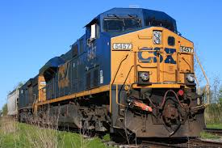
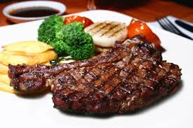
Why is it important to check for understanding along the way?

Slide 42
Written Responses
Hold up paper
White boards
Ready Responses
Hands up when ready
Personal Chalkboards
Answers on cards
Thinker’s chin
Stand up when ready
Put your pen on your paper when ready
All eyes on teacher
Making Choices
Open hand/closed hand
Ranking
Rank with your fingers
Thumbs/Pens up/down
Number wheels
Green card/red card
Move to the corner/spot
Rank with your arm
Line up according to response
Knocking/clapping/
cheering

Slide 43
Find the Fib!
Students may work in pairs or small groups.
Students have three post-its/index cards with the numbers “1, 2, 3” in each card.
Teacher writes 3 statements on the board (one false, two true) and students decide which one is the fib.
On signal from teacher, students show the number of the statement they believe is the fib.

Slide 44
Let’s Play!
Find the Fib
Evaporation is part of the water cycle
Refraction is part of the water cycle
Condensation is part of the water cycle
      I believe number… is a fib because…

Slide 45
Find the Fib
Cognitive and academic development in native language has an important and positive effect on second language acquisition.
Once students can speak English, they are ready to undertake the academic tasks of the mainstream classroom.
According to research, students in ESL-only programs, with no schooling in their native language, take 7-10 years to reach grade level norms.
Let’s Play!

Slide 46
Let’s Play!
Find the Correct Answer
Rhea is a moon of Saturn. Which of these facts about Rhea best indicates that it does not have a water cycle in which water changes state?
A Its radius is 765 km.
B Its density is about 1.3 kg/m3.
C Its period of rotation is about 4.5 Earth days.
D Its temperature is between −174°C and −220°C.

Slide 47
SHELTERED INSTRUCTION
Content and Language Objective
Using Complete Sentences
Randomization Techniques
Total Response Signals

Slide 48
Developing academic vocabulary

Slide 49
1. When you can complete this sentence in your mind, please stand up.
Academic vocabulary development is important for ALL students, but especially for ELLs, because…
2. Find your 9 o’clock appointment and share your responses.

Slide 50
What does this mean?
Carving is appropriate for most green and blue slopes and even some black slopes. However, if you try to carve through moguls, especially in packed powder or corn snow, you’re going to face-plant.

Slide 51
What does this mean?
Carving is appropriate for most green and blue slopes and even some black slopes. However, if you try to carve through moguls, especially in packed powder or corn snow, you’re going to face-plant.

Slide 52
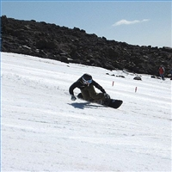
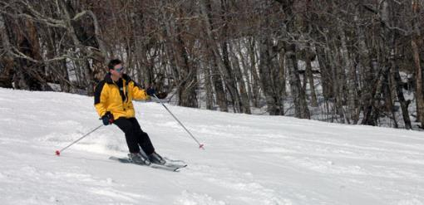
Would this help?
These men are carving.

Slide 53
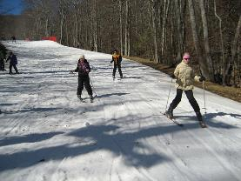
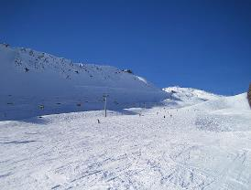
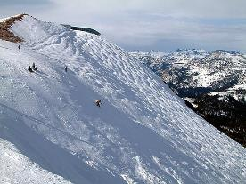
How about this?
Green Slope
Blue Slope
Black Slope

Slide 54
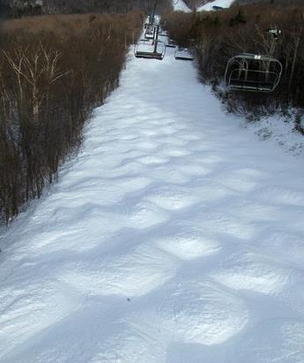
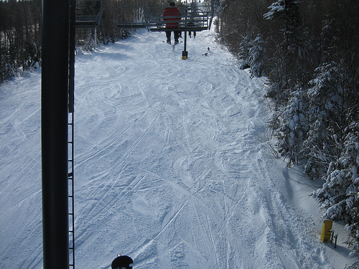
Moguls Packed Powder

Slide 55
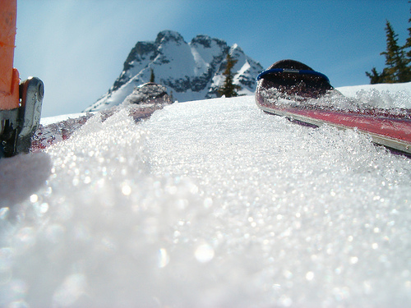
Corn Snow

Slide 56
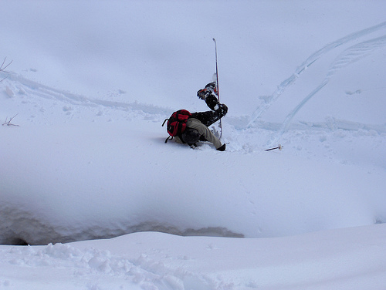
Face-plant

Slide 57
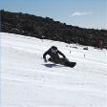








Carving is appropriate for most green and blue slopes
and even some black slopes. However, if you try to carve
through moguls, especially in packed powder or corn snow
you’re going to face-plant.
apropiado
especialmente

Slide 58
Vocabulary Gallery
Each table researches a different vocabulary strategy
Each team creates a poster explaining the activity
Walk freely through the Vocabulary Gallery!
Gallery Walk

Slide 59
SHELTERED INSTRUCTION
Content and Language Objective
Using Complete Sentences
Randomization Techniques
Total Response Signals
Developing Academic Vocabulary

Slide 60
Structured reading and writing activities

Slide 61
Structured Language Activities
Adapted Texts
SQP2RS
Graphic Organizers
Thinking Maps
Jigsaw Reading
Outlines
Highlighted Texts
1-2-4-All
Round Table
Taped Texts
Marginal Notes
Native Language Texts
Write-Read-Read-Trade

Slide 62
SQP2RS
Survey: Preview text
Question: 1-3 questions
Predict: 1-3 predictions
Read: Read text
Respond: Answer, modify, drop, add questions
Summarize: Retell the main points of the text

Slide 63
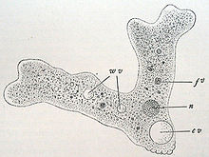
Amoebas
Amoebas are microscopic organisms, about the size of the head of a pin. They are one of the simplest protozoa. Amoebas live in rivers and ponds, typically on the leaves of plants that live in water.
Amoebas are very small organisms. They are about as big as the head of a pin. They are one of the simplest protozoa. Amoebas live in rivers and ponds. They can also be found on the leaves of plants that live in water.
Amoebas are very small. They are about as big as the head of a pin. They are very simple. They live in rivers and ponds. They can also be found on the leaves of plants that live in water.

Slide 64
The American Revolution
In April 1775, British General Thomas Gage was sent to Boston
to locate and take possession of the colonists’ stockpile of guns and gunpowder. Paul Revere and the other Sons of Liberty discovered his plan. Revere, William Dawes, and Samuel Prescott jumped on their horses. They rode through the night to warn the colonists that the British were coming. Colonists called “minutemen” were ready to fight within minutes of getting these warnings.
It was April 1775. British General Thomas Gage went to Boston. He
planned to find and take the guns that belonged to the colonists. He also wanted their gunpowder. The Sons of Liberty found out about this plan. Three men got on horses. Paul Revere was one of these men. The men rode in the dark. They told colonists that the British were coming. Some colonists got ready to fight in a few minutes. These men were called “minutemen.”

Slide 65
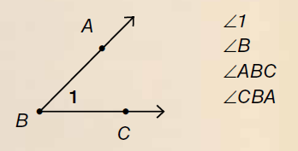
Angles
There are three ways to identify angles: by number, by the vertex, or by three points. If we use three points, they must consist of a point on one ray, the vertex, and a point on the other ray. If you use three points to name an angle, the vertex must be the second point in the name (∠ABC).
There are three ways to name angles. We can name them by number. We can name them by the vertex. We can name them with three points. One point is on one ray. One point is on the vertex. One point is on the other ray. The vertex must be the second point in the name (∠ABC).

Slide 66
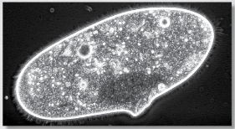
How would you adapt this text?
Paramecia
The most common protozoa is the paramecium. While it is very small, you can actually see paramecia without the use of a microscope. They are big enough that you can see them in water with the naked eye. The paramecia look like gray specks.
Paramecia
The paramecium is a kind of protozoa. It is the most common kind. They are big for microbes. You can see them with your eyes. You don’t need a microscope. They look like gray specks in a body of water.

Slide 67
Go to your 3 o’clock
One of the benefits of including structured reading and writing activities in my classroom is…
One of the challenges of including structured reading and writing activities in my class is…
Something I can do to overcome this challenge is…

Slide 68
SHELTERED INSTRUCTION
Content and Language Objective
Using Complete Sentences
Randomization Techniques
Total Response Signals
Developing Academic Vocabulary
Structured Reading Activities

Slide 69
Structured conversations

Slide 70

Structured Conversations
Think-Pair-Share
Think-Write-Pair-Share
Question-Signal-Stem-Share-Assess
Expert Gallery Walk
Three-Step Interview
1-2-4-All

Slide 71
SHELTERED INSTRUCTION
Content and Language Objective
Using Complete Sentences
Randomization Techniques
Total Response Signals
Developing Academic Vocabulary
Structured Reading Activities
Structured Conversations

Slide 72
Session Objectives
Content Objective
Language Objective
Today I will explore sheltered instruction techniques and strategies to make content comprehensible for my ELLs.
Today I will share different ideas on how to implement sheltered instruction strategies in my classroom.

Slide 73
PlANNING FOR SUCCESS
With Thinking Maps

Slide 74
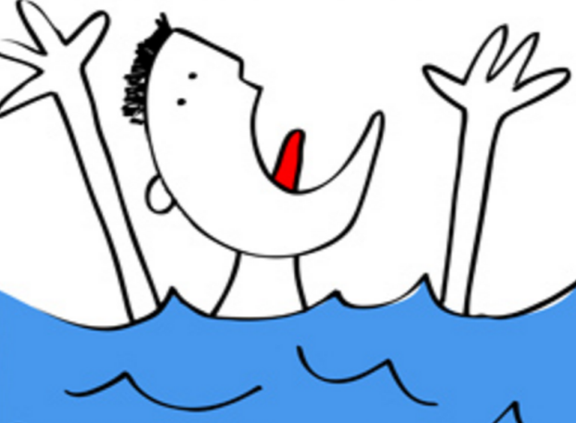
Struggling School Temptation
initiatives
initiatives
initiatives
initiatives
initiatives

Slide 75





What are Thinking Maps?
Visual
Patterns
Used in combination for depth and complexity
Based on
8 Cognitive Skills
Thinking
Maps®
Applied in all content areas
Used by all teachers

Slide 76
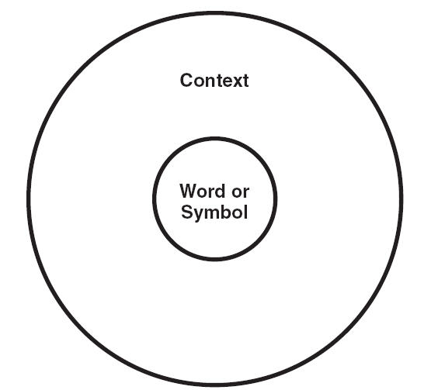
Circle Map
Initiative #1
Initiative #4
Initiative #2
School
Initiatives
Initiative #3

Slide 77
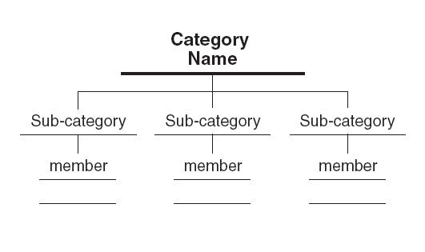
Tree Map
School
Initiatives
Category Title
Category Title
Category Title
Initiative #1
Initiative #3
Initiative #4
Initiative #2

Slide 78
Multi-Flow Map
Causes
Effects
Implement Initiative #1

Slide 79
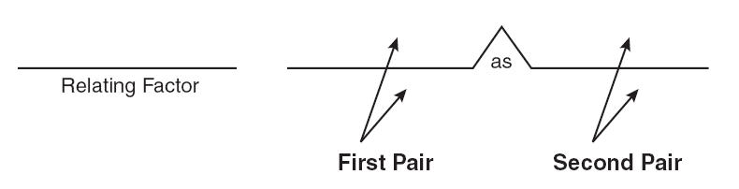
Bridge Map
Initiative #1
Initiative #2
has the primary purpose of
Purpose
Purpose

Slide 80
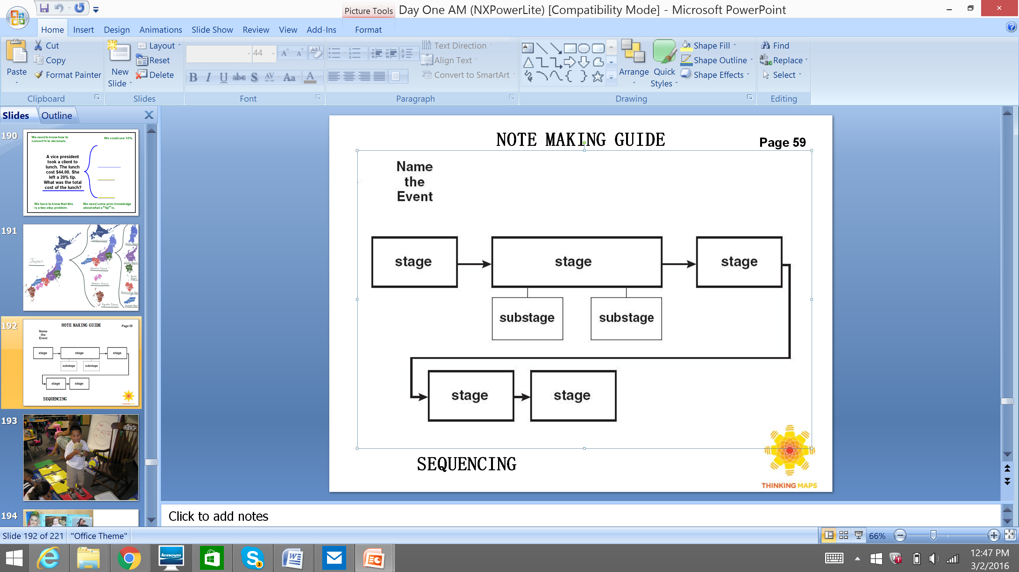
Flow Map
Initiative #1

Slide 81

Now what?
Next Steps

Slide 82

Tickets Out
I used to think…
But now I know…

Slide 83
Thank you for your participation in the
ELL Leadership Academy!
Karina E. Chapa, M.Ed.
Language Proficiency, Biliteracy and Cultural Diversity Director
kchapa@esc1.net
Facebook: Region One ESC Bilingual
Twitter @esc1bilingual

